Slide 1
Career Planning
  Career planning & development
  Personal branding
  Job hunting & networking
  Job interviews & salaries
Andreas Torén
Career Center
careercenter@ju.se
www.ju.se/careercenter
www.facebook.com/careercenterju

Slide 2
Career Planning
A life long continuos process where you explore:
  Where you are in your life and career
  What you want to do and where you want to go in the future
  Set your goals and develop your actionplan

Slide 3
Career Development
Some different viewpoints?
What is Career Development for you?

Slide 4

Always upwards?

Slide 5
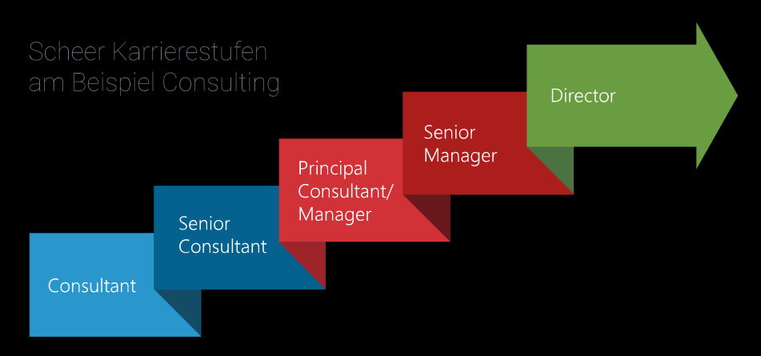
Everybody wants to be an CEO?

Slide 6
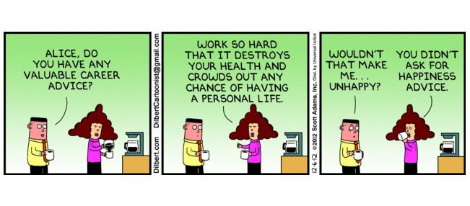
Work Life balance?

Slide 7
Career Development
What type of career do you want?
Self assesment (what is important for me)
What type of career path am I looking for?
4 main different Career development paths

Slide 8
Self Assessment
Refeclet upon:
  Who am I and what do I want to do?
  What is my vision and my goals for the future?
  What have I done in Life and Work life and why?
  What is important for me?
  What are my values?
  What is my dream job?
  Why do I get up in the morning?

Slide 9





Career development Paths
Career Path
Motion
Time frame
Expert
Deeper
For life
Linear
Uppwards
As fast as po..
Sideways /
related
5 –10 years
Expanding
Varied /
unrelated
2 – 4 years
Episodic

Slide 10




MOTIVES
Expert
Linear
Expanding
Episodic
In-depth
knowledge
Security
Power
Performance
Personal
development
Creativity
Variation
Independence
Notes:
10

Slide 11
Expert
Driven by: knowledge & quality
Occupations: research, specialist, psychologist, professor, Phd..
Likes: being in control
Hates: reorganisations, change in general

Slide 12
Linear
Driven by: power, performance, results, success and sometimes status and money
Occupations: the higher the better, leadership positions, CEO, consultant, project manager,
Likes: making desicions, being in charge, leading reorganisations
Hates: any obstacles from conquering the world

Slide 13
Expanding
Driven by: own and others devolopment, challenges, energy and motivation
Occupations: project manager, designer, new media, marketing,
Likes: using transferable skills, changing places and works tasks (but with and idea of whats coming)
Hates: staying around to long (5-10 years)

Slide 14
Episodic
Driven by: variation and independence
Occupations: shorter projects, great variation, entrepreneurs
Likes: networking, changing places and work tasks
Hates: managers, staying around at all (2-4 years)

Slide 15
So who are you?
Probably an expert or a mix of 2 (or more) categories!
or?

Slide 16
4 steps -Career Planning
Your Goals - use your soon to be SMART goals
Information
Time Schedule
Action plan!

Slide 17
Self Assessment
What is your goals 10, 5 or 1 year from now?
  For your personal life?
  For your work life?
    What kind of organization or company? What field?
    What does your position look like? Role, projects, results, coworkers, manager, salary, career opportunities….?
  What is your goal for today?
  How will my goal for today, this month or this year lead to my goals for 1, 5 or 10 years from now.

Slide 18
SMART Goals
Make your goals SMART:
  Specific, Measurable, Achievable,
  Relevant, Time-bound
Examples:
”Finish my PhD in 2020 and start to work at JTH/Moelven/Daloc/Volvo within R&D”
”Start my own business as a management consultant focused on production in Canada before 2025”

Slide 19
4 steps -Career Planning
Your Goals - use your soon to be SMART goals
Information
Time Schedule
Action plan!

Slide 20
Information
What do you need to know?
  Job titles and or academic ranks/titles?
  Relevant Universities?
  Relevant Companies, research partners?
  Branch and labour market information?
  Geographical labour market?

Slide 21
Academic ranks/Titles
There are differences between academic titles and academic ranks. They are not always saying anything about which type of position they have. Sometimes a title can be both but you can also be an unempoyed Professor.
Professor - can be both rank and title
Professor emeritus/ emerita retired or semi-retired professor.
Docent - title after a Phd.
Lektor - can be both rank and title. Teacher with a PhD. Can also be a promoted Adjunkt.
Doktor - only title.
Licentiat - Only title.
Doktorand - both title and rank. Ongoing Phd studies.
Adjunkt - both a rank and a title. Non PhD teacher. Within pedagogy also atitle.

Slide 22
Academic Ranks/Titles
Researcher level
  Licentiate (Licentiat)
  Doctor (Doktor)
Higher titles
  Docent (Docent)
  Adjunct Professor (Adjungerad professor)
  Lecturer (Adjunkt)
  Assistant professor (Forskarassistent)
  Associate Professor (Lektor)
  Postdoc (Postdok)

Slide 23
Academic Ranks/Titles
Higher titles (some variation)
  Head of Faculty (Prefekt or Dean)
  Deputy Head of Faculty (Proprefekt)
  Professor (Professor)
  Professor Emeritus (Professor Emeritus)
  Deputy or Vice President (Prorektor)
  President (Rektor)

Slide 24
Practice drill - Homework
Go to Monster.com and/or academicpositions.eu and find the 100 most interesting job advertisments
  Dont start by reading the requirements
Conclusions
  Branch, Universities and companies
  Research areas/departments
  Products or Services
  Job or academic titles
  Locations
Use the results when you plan and jobhunt

Slide 25
Practice drill - Homework
For a career in the private/public sector:
Go to a company database such as
  www.europages.com
  www.allabolag.se
  www.offentliglistan.se (Public sector in Sweden)
Look for organisations;
  Branch
  Areas/departments
  Products or Services
  Job titles
  Locations
Use the results when you plan and jobhunt

Slide 26
Practice drill - Homework
For academic career:
Google for Top Universites list or Universities in sweden/europe/globally
Look for Universities focused on
  Your Research
  Areas/departments
  Products or Services
  Job titles and locations
Use the results when you plan and jobhunt

Slide 27
Useful links
www.ju.se/careercenter
  Company databases
  Job portals / Miniguide
Science parks
  www.sciencepark.se
  www.sisp.se
  www.unesco.org/new/en/natural-sciences/science-technology/university-industry-partnerships/science-parks-around-the-world/
For jobs in Sweden and Europe
www.eures.europa.eu

Slide 28
Academic Positions - LINKS
www.academicpositions.se
www.academicpositions.eu
www.academicpositions.com
www.universitetslararen.se/platsannonser/
www.universitetsjobb.se
www.akademikerjobb.se
https://universitetsvakanser.se/
www.timeshighereducation.com/unijobs
www.higheredjobs.com
www.indeed.com/q-International-Faculty-Position-jobs
www.globalacademyjobs.com/
www.eui.eu/ProgrammesAndFellowships/AcademicCareersObservatory/JobFundingResources/InternationalJobDatabases

Slide 29
Useful Links
Chambers of Commerce
www.swedishchambers.se
www.chambertrade.com
International Databases
http://se.kompass.com/en
http://www.europages.com/
http://researchguides.library.tufts.edu/CompanyResearch

Slide 30
Labour Market information
Google for
  Country specific Labour Market Information
  For Europe, see www.eures.europa.eu
  Country specific Company/University databases

Slide 31
4 steps -Career Planning
Your Goals
Information
Time Schedule
Action plan!

Slide 32
Time Schedule
Apply for advertised jobs?
Contact companies/universities?
Alert my contacts?
= I found a Job!
Start to plan my next step in my Career?

Slide 33
4 steps -Career Planning
Your Goals
Information
Time Schedule
Action plan!

Slide 34
Action plan
A to do-list based on your goals.
Specific actions you have to take to get closer to your goal.
Homework:
Write down 5 things you can do the next 3-6 months to get closer to your goals.
Write a realistic plan for the next step of your career.

Slide 35
Action plan - Example
To-do list!
  Update/get feedback on my CV and Cover letter
  Update/create a Linkedin profile
    Get 50 new contacts on my LinkedIn profile
    Join groups and follow interesting organisations
  Go to Career Fairs/Conferences
  Make a list of 30 Universities to contact
  Make a list of 100 companies for prospecting letter

Slide 36
Approach – LinkedIn
LinkedIn
  Focus on the professional you!
  Put it in order of relevance
  CV/Resume - only the most important experiences
  Searchwords – how will they find you?
Help each other!
Join interesting groups/forums
  Be active, make them want to add you!

Slide 37
Action plan – Back up
Have alternative plans
  If I do not get XXXXXXX there is always…
  Apply to many Job advertisments
  Send prospecting letters
  Alert my former employers
  Apply for courses etc..
  Career Planning/Counselling is based on options!

Slide 38
4 steps -Career Planning
Your Goals
Information
Time Schedule
Action plan!

Slide 39

Career development

Slide 40

Career Development

Slide 41

Career Development

Slide 42

Career Development

Slide 43
Break!

Slide 44
Personal Branding
Andreas Torén
Career Center
careercenter@ju.se
www.ju.se/careercenter
www.facebook.com/careercenterju
Notes:
Presentera mig
Presentera Career Center Career guidance, ask us to help with your personal brand.
More deeper lecture today..
Career planning on Thursday, same room, same time..

Slide 45
Why personal branding?
2 minutes, talk among yourselves?

Slide 46
Why personal branding?
Trends of today and tomorrows job market require more and more personal branding!

Slide 47

Today it´s all about ….
STANDING OUT!

Slide 48

Reverse referencing

Slide 49
Brand = Your promise
Brand = added values
Only exists in the beholders awareness
Product/service = functional values
A brand; emotional values – promises

Slide 50
3 steps of
Personal Branding
1. Self assessment
2. Communicating
3. Controlling

Slide 51
1. Self assessment
  What are my strenghts
  What are my interests/passion
  What are my best skills/competences/experiences
  Where is my expertise
How do I describe myself?
How do I think others describe me?
How do I want others to describe me?
How do they really describe me?

Slide 52
Strenghts - method
Invite a colleague/co-worker to a fika
Tell them to prepare strengths and weaknesses and you will do the same for them.
Discuss and analyse!

Slide 53
Example - education
MARKETING management
Marketing MANAGEMENT
MARKETING MANAGEMENT

Slide 54
Example - education
Everybody who studies economy can´t work at PWC or EY
But all companies needs people who have studied economy
Which companies needs my skills?
What transferable skills do I have?

Slide 55
1. Self assessment
Write down all positive feedback you got from;
  Employers
    What does it says in your reference letters/documents
  Your network
  During Interviews
  Teachers
  Collegeaus and friends
And some Negative feedback
  Rename it ”List of upcoming Improvements”
  But remember we can´t all be perfect

Slide 56
1. Self assessment
Summarise and Analyse
  What were the key words?
  Which words were most often repeated?
  What do I want to add?
Choose your 5-7 key words to describe your brand

Slide 57
2. Communicating
The key words are also always your
  Strengths
    On your CV and in your Cover letter
    For interviews
    In your elevator ”pitch” – elevator speech
  Search words for LinkedIn
  In your profiles
Be consistent!
Use them often!

Slide 58
2. Communicating
Build your tag line: L’Oréal, Spiderman or IKEA
Examples:
  Career Counsellor with an open and curious mindset, positive outlook, in-depth knowledge and who loves to communicate or at least to talk!
  Creative Engineer with experience from the Aviation industry focusing on project management and with updated competences within management.

Slide 59
1. Self assessment
Find your success stories:
  What challenges have you gone trough?
  What have you won in your life?
  What professional success have you had?
  What educational success have you had?
  Where have you shown your passion?
  What problems have you solved?

Slide 60
2. Communicating
Your success stories are also always your:
  Examples
    On your CV and in your Cover letter
    For interviews
    In your elevator ”pitch” – elevator speech
  In your LinkedIn Profile
Be consistent!
Use them often!

Slide 61
1. Self Assessment
What is your goals 10, 5 or 1 year from now?
  For your work life?
    What kind of organization or company? What field?
    What does your position look like? Role, projects, results, coworkers, manager, salary, career opportunities….?
Use you SMART goals

Slide 62
1. Self Assessment
What is your target group?
  Universities
  Future employers?
  Future clients?
Who are your competitors?
  In your future job market?

Slide 63
2. Communicating
Your goals are always:
  Although somewhat adapted:
    On your CV and in your Cover letter
    For interviews
    In your elevator ”pitch” – elevator speech
  In your LinkedIn Profile
Be consistent!
Use them often!

Slide 64
2. Communicating
Your target group is always your focus
  What do they want?
  How can they find you?
  How can I help them find me?
My competitors
  What do I have that they don´t have?
  What is my Unique Selling Point (USP)?

Slide 65
3. Controlling
Communication plan
  Why am I using?
    CV, Cover letters and Prospecting letters? Portfolio?
    LinkedIn, Facebook, Instagram, Twitter, Blogg, Webpage
  What should I really use?
    Reach my targets group or clients?
    What time do I really have to manage it?
  If they Google me?
    What will they find?
    How can I control or change that?

Slide 66
CV & Cover letters
Different approach for different targets groups
Academic career
  Focus on the academic side
  Education, publications, conferences, academic projects, work experience, language skills, IT skills..
Private or public sector
  Education, work experience, projects, language skills, IT skills, academic projects, publications and conferenses (a selection)..

Slide 67
Controlling your brand
How I look..
How I behave..
How I am percieved..
How I present myself..
How you communicate who you are..
What others are saying about you behind your back..

Slide 68
Your Brand is…
Identity
My own view
Profile
How others view myself
Brand
How I want to be
percieved by others

Slide 69
3 steps of
Personal Branding
1. Self assessment
2. Communicating
3. Controlling

Slide 70
Job-hunting – How do you find jobs?
  Information about Methods and Tools you can use to find companies and
  job opportunities.
Andreas Torén
Career Center
careercenter@ju.se
www.ju.se/careercenter
www.facebook.com/careercenterju

Slide 71
Always think about
Language Barriers!
Contacts always important!
Big companies are always easier?
Cultural differences?

Slide 72
Always think about
Which organisations can I Contact?
What contacts do my University have?
  Host Companies
  Research Partners
  Thesis Partners (on all levels)

Slide 73
Always Contact
Previous employers
Companies you collaborated with
Companies interested in your research
Big companies in your branch
Companies from your geograpical market
= WHY? – They don´t always know you exist!
Send prospecting letters!

Slide 74
Networking
Everybody have contacts, do not use just your own
Go to career fairs, conferences and mingles and try to focus on the person, not just the company
  Mingle phobia, 90% has it..
Build contacts wherever you are, get to know everyone and add them on LinkedIn
Always follow up on contacts
  Send prospecting letters, call them, invite them to lunch..

Slide 75
Job interviews
Ask questions when they invite you
Always prepare and practice
  Analyse the organisation
  Practice your presentation of you and your research area
  Prepare examples
  Practice common interview questions
  Prepare your own questions
Good or bad interviewers..
Don´t overanalyse rejections.. to early..

Slide 76
Salaries
Always look for the statistics
  www.saco.se/studieval/yrken-a-o/larareforskare-vid-universitet-och-hogskola
  www.arkiv.sverigesingenjorer.se/About-us/salaries/
  www.glassdoor.com/Salaries
Let them say the number first..
  Do not say an exact amount (37000-41000sek per month)
    Depends on responsibility
    Other benifits, overtime etc.

Slide 77
Career Center
We offer:
  Career Counselling
  Feedback on job applications
  Simulated Job interviews
  Labour market information
  LinkedIn feedback
  Open lectures programme (sign up)
  andreas.toren@ju.se
  careercenter@ju.se

Slide 78
An Alumnus story
Özge Öner, PhD
University of Cambridge,
Department of Land Economy
https://www.landecon.cam.ac.uk/
Research Institute of Industrial Economics
-IFN
8th of May, 12-13, details will come shortly!

